Slide 1


What’s Coronavirus? And how will it affect people living in correctional facilities?
A presentation for justice-involved persons
Anne C. Spaulding MD MPH
March 4, 2020
Emory Center for the
Health of Incarcerated Persons
Aspauld@emory.edu
Development of these slides was supported under cooperative agreement, the Centers for Disease Control and Prevention’s (CDC’s) Collaboration with Academia to Strengthen Public Health Workforce Capacity (grant no. 3 U36 OE000002-04 S05) funded by CDC, Office of Public Health Preparedness and Response, through the Association of Schools and Programs of Public Health (ASPPH). Its contents are solely the responsibility of the authors and do not necessarily represent the official views of CDC, the Department of Health and Human Services, or ASPPH. Please do not alter content without contacting author.

Slide 2

What is Coronavirus? What is COVID-19?
You may have heard about “the new coronavirus”
There many types of viruses out there. Most coronaviruses cause a mild cold.
The “new coronavirus” causes a disease called “COVID-19”. Some infections are mild. Some people get a cough, fever and shortness of breath. A few need to be hospitalized.
Some people are dying, but at a lower rate than with other epidemics like SARS.
Coronaviruses are named for the crown-like spikes on their surface.
This is a virus particle magnified a zillion times

Slide 3
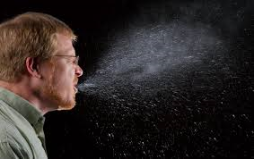
The New Coronavirus Overview: Spread
This virus spreads from person-to-person
When people are in close contact, about 6 feet of each other or closer.
The longer you are close together, the higher the likelihood of spread.
When you cough or sneeze, droplets with virus particles spread in the air. Droplets can land in mouths or noses of people nearby.
Droplets can be inhaled into the lungs.
Sometimes a jail or prison will want to separate sick people and people who don’t have the infection. With an outbreak, visitation may be stopped.

Slide 4

The New Coronavirus Overview: Spread
“Novel” is another word for new. Some people refer to this as “The Novel Coronavirus”
The new virus can spread by touching with bare hands a surface or object that has the virus particles on it, such as a used tissue.
This is not the main way the virus spreads!
The novel coronavirus can spread at different stages of sickness
People are thought to be most contagious when they are sickest.
People might be contagious before they even show symptoms,
but probably most people with COVID-19 did not catch
the virus from folks who are still well.

Slide 5


New Coronavirus Overview: Spread
It started in China
As of March 2020, it has spread to every continent.
COVID-19 seems to be spreading easily in many communities
Persons entering jails or prisons can bring it in with them.
If it’s in a community,
it’s likely to show up
in their local jail (or prison).

Slide 6
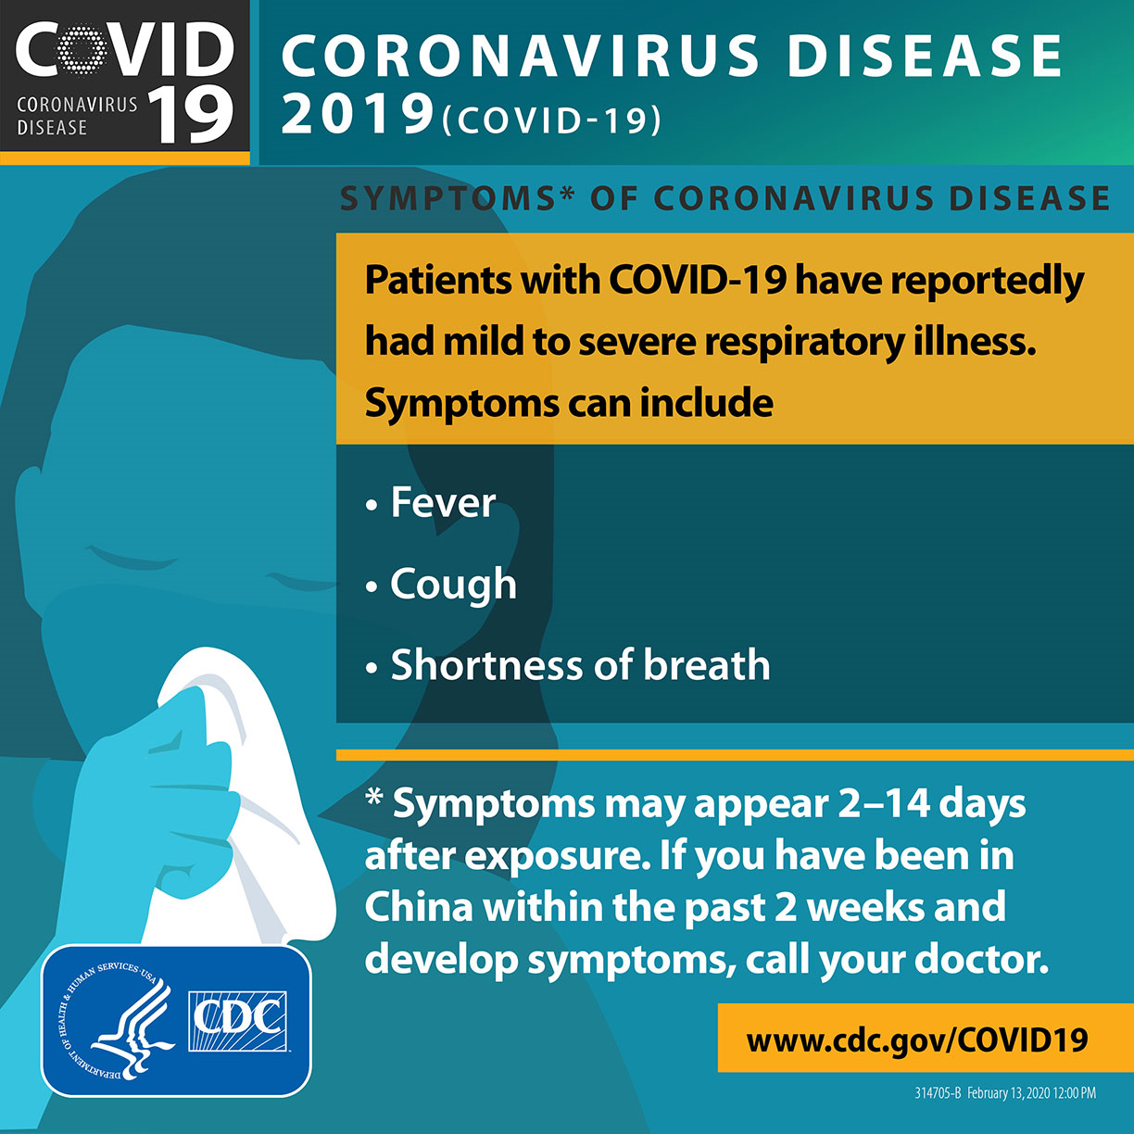
New Coronavirus Overview: Symptoms
Many infected people have reported mild symptoms or no symptoms at all
Symptoms can appear soon or long after contact with an infected person
This could be 2 days, 2 weeks, or sometime in between!
Symptoms are listed here
Serious disease and death are most common in
Older persons
Those with underlying medical conditions

Slide 7
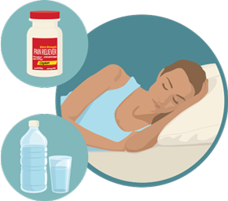
New Coronavirus Overview: Treatment
Treatment
Rest
Drink fluids
Take medicine to reduce fever (for example, acetaminophen).
Research is ongoing to use already-developed medications to better treatment.
Prevention
Research is ongoing to develop
a vaccine to prevent infection.

Slide 8
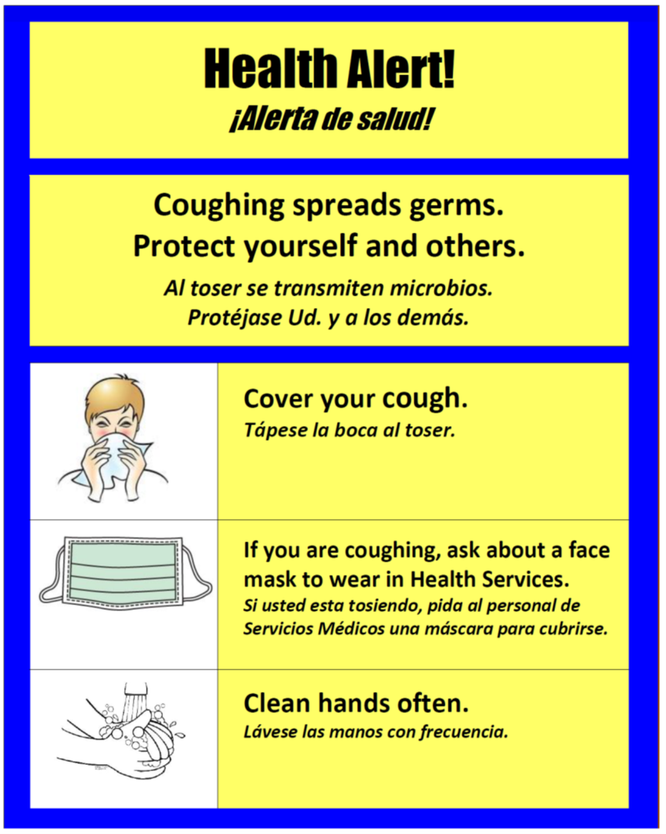
New Coronavirus Overview: Prevention—Avoid Exposure!
Avoid close contact with people who are sick
Avoid touching your eyes, nose, and mouth
Cover your cough or sneeze with a tissue
Throw the tissue in the trash
Wash your hands often with soap and water for at least 20 seconds
As long as singing Happy Birthday song!
Ask for a facemask if you have symptoms
Masks are for people who are sick, to prevent them from spreading the infection to others

Slide 9
New Coronavirus Overview: Incarceration
Prisons and jails are enclosed environments
Incarcerated persons sleep in close quarters,
eat together,
recreate in small spaces,
and may be at increased risk for airborne infections due to close contact
If you:
Develop symptoms of COVID-19,
Have been in close contact with someone with COVID-19, or
Have recently traveled from/through an area with widespread cases,
Let health services know!

Slide 10
Resources:
https://www.cdc.gov/coronavirus/2019-ncov/index.html
https://www.bop.gov/resources/pdfs/seasonal_influenza_guidance.pdf
Questions? Aspauld@emory.edu
Emory Center for the Health of Incarcerated Persons, Atlanta GA
Acknowledgments: I am grateful for constructive criticism from countless colleagues who are federal employees.

